Slide 1
Sequence Similarity & Searching
BIOCHEM 3BP3

Slide 2
What questions can sequence analysis answer?
I have obtained a DNA sequence via PCR and Sanger sequencing – did I amplify the right sequence?
I have been sequencing a genome and have predicted Open Reading Frames and I want to know what they encode
I want to find my gene of interest in a genome sequence
I want to predict functional domains or motifs for my protein sequence
I want to know which regulatory binding sites are 5’ of my gene

Slide 3
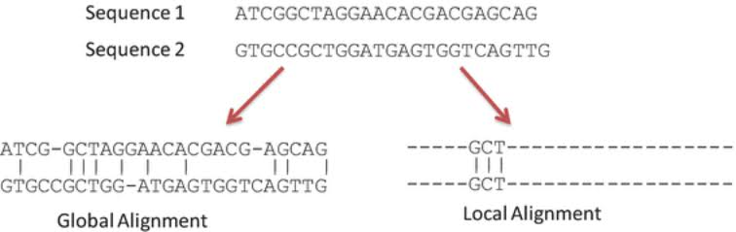
Local vs global alignment
A local alignment algorithm doesn't ask "what's the best way to line up these two sequences from start to finish?" It asks: "what is the highest-scoring alignment between any substring of sequence A and any substring of sequence B?" Regions with no meaningful similarity simply don't participate

Slide 4
Focusing on three methods
1
Local sequence alignment, e.g. BLAST
Approximates local alignment at scale
2
Hidden Markov Models, e.g. Pfam/Hmmer
Motif detection, e.g. PROSITE & PSSMs
Probabilistic models of ”what a region should look like”
3

Slide 5
Learning Objectives
By the end of this lecture, you should be able to:
Explain why local alignment, not global, is the right tool for detecting conserved domains in divergent sequences
Describe BLAST's seed-and-extend strategy and explain why it trades exactness for speed.
Interpret a BLAST bit score and E-value, and know what each does and doesn't tell you.
Define a Hidden Markov Model and describe how HMMs represent protein families.

Slide 6
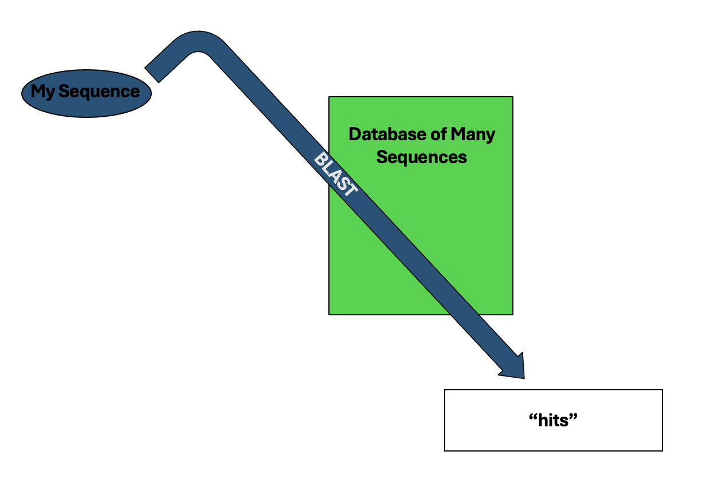
Basic Local Alignment Search Tool (BLAST)

Slide 7
Basic Local Alignment Search Tool (BLAST)
Before BLAST: Smith-Waterman
dynamic programming alignment algorithms to compare the query against each sequence in the database
each comparison is an exhaustive comparison of each nucleotide or amino acid against all others
it won’t miss anything, but processing and memory intensive

Slide 8
Basic Local Alignment Search Tool (BLAST)
BLAST
novel decrease in the search space
creates a “word list” from the query sequence with words of a specific length (w)
local alignments only explored where “words” have complete match to the query
short word matching is very amenable to computing – fast and lower memory needs

Slide 9
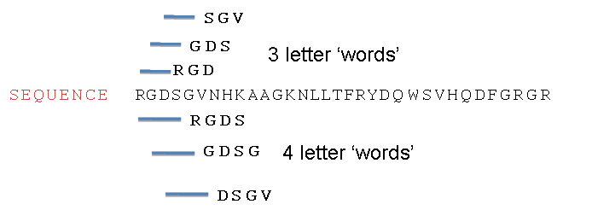
Basic Local Alignment Search Tool (BLAST)
BLAST
novel decrease in the search space
creates a “word list” from the query sequence with words of a specific length (w)
local alignments only explored where “words” have complete match to the query
short word matching is very amenable to computing – fast and lower memory needs
word size
resolution
runtime
BLAST defaults (w=11 for DNA, w=3 for protein) are often sufficient – but not always!

Slide 10
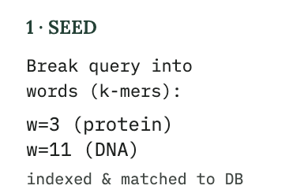
Basic Local Alignment Search Tool (BLAST)

Slide 11
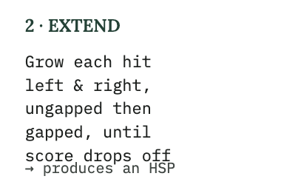
Basic Local Alignment Search Tool (BLAST)
Extension stops once the score falls a set amount (X) below the best score seen so far — there's no benefit in dragging a bad region along once the good stretch has clearly ended. This produces a High Segment Pair (HSP).

Slide 12
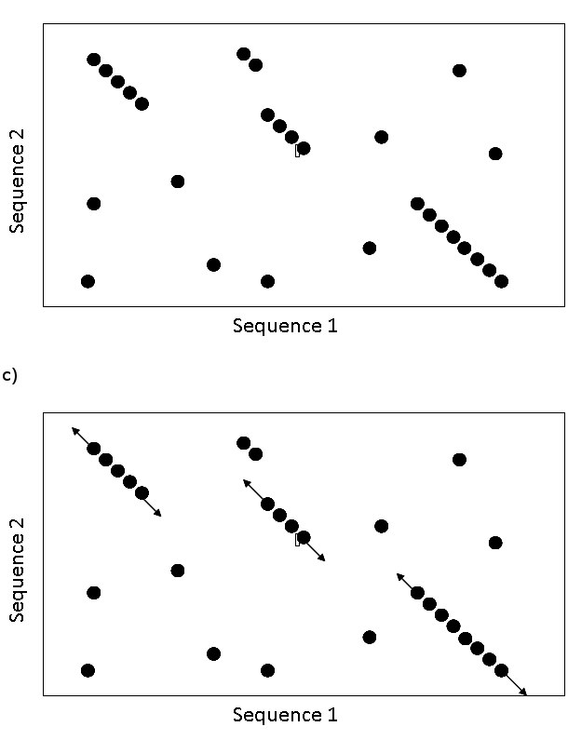
Basic Local Alignment Search Tool (BLAST)
High Scoring Pair (HSP)

Slide 13
Basic Local Alignment Search Tool (BLAST)
High Scoring Pair (HSP)

Slide 14
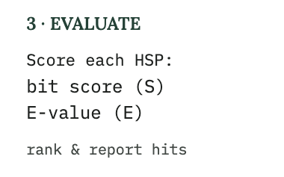
Basic Local Alignment Search Tool (BLAST)
High Scoring Pair (HSP)

Slide 15
A High Scoring Pair (HSP)
219 – (3-1) + 1 gap = 218
3rd amino acid is a part of the alignment

Slide 16
A High Scoring Pair (HSP)
Exact matches
Conservative
change
Gaps

Slide 17
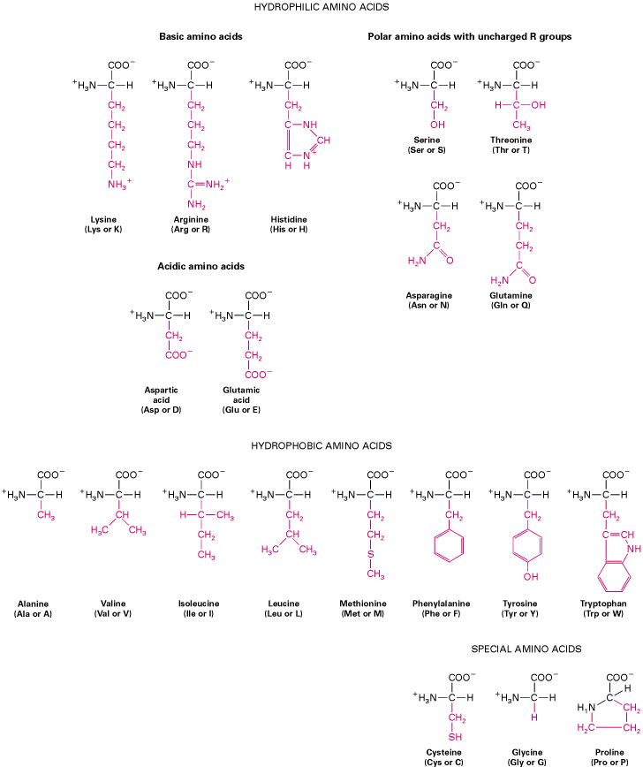
A High Scoring Pair (HSP)
conservative = similar physico-chemical properties
Conservative
change
Exact matches
Gaps

Slide 18
A High Scoring Pair (HSP)
conservative = similar physico-chemical properties
Exact matches
Exact matches + conservative changes
Gaps

Slide 19
A High Scoring Pair (HSP)
The bit score gives an indication of how good the alignment is; a bit is a measure of information content; the higher the score, the better the alignment. Bit score uses identity, positives, and gaps (i.e. all data).
Bit score is independent of query sequence length and database size (i.e. normalized) allowing comparison among different searches or databases.

Slide 20
A High Scoring Pair (HSP)
The expectation value (e-value) estimates the likelihood that a given sequence match is purely by chance. The lower the expectation value, the less likely the database match is a result of random chance.
E-value is a function of database size – how good is the database’s sample of “sequence space” to determine random matches?

Slide 21
A High Scoring Pair (HSP)
As a database grows, the same search will produce an altered expectation value. Different sized databases will produce different expectation values for the same HSPs.
There is no “best” expectation value but some generalizations are used: e⁻¹⁰ or smaller is worth examining; 0.01 or larger is noise.

Slide 22
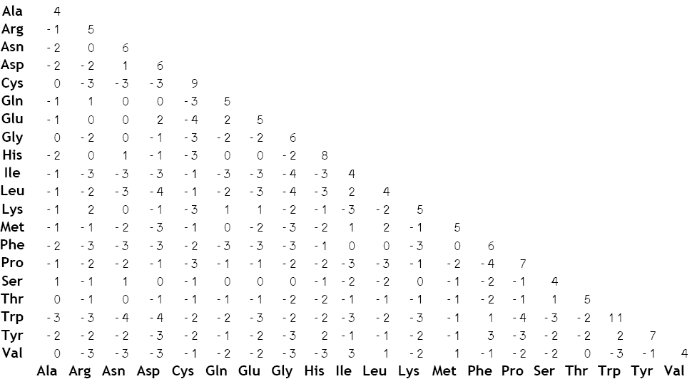
How does BLAST use physio-chemical properties?
BLOSUM62 matrix (BLOcks SUbstitution Matrix) reflects the relative rate of substitution among amino acids observed in conserved regions (no more than 62% similarity) of known protein sequences.
BLOSUM62 is the BLAST default. Since is it based on conserved regions with 62% similarity or less it is among the best for detecting most weak protein similarities.
Other BLOSUM or PAM matrices exist for detection of more or less divergent proteins.
conservative = similar physico-chemical properties

Slide 23
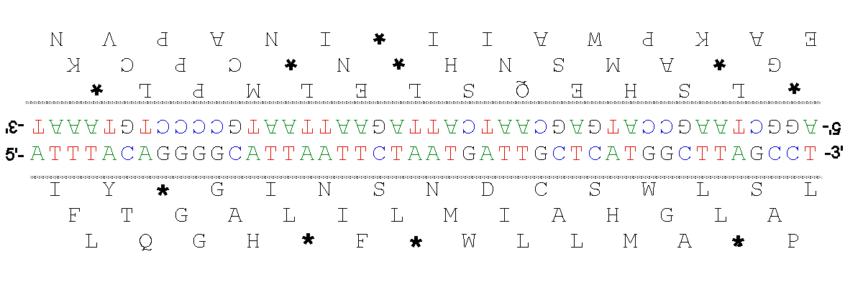
BLAST Programs
Program | Query | Database | Use Care
BLASTN | Nucleotide | Nucleotide | Find matching DNA/RNA sequence
BLASTP | Protein | Protein | Find protein with similar sequence
BLASTX | Nucleotide (6-frame translated) | Protein | Identify coding region in DNA

Slide 24
BLAST Programs
Program | Query | Database | Use Care
BLASTN | Nucleotide | Nucleotide | Find matching DNA/RNA sequence
BLASTP | Protein | Protein | Find protein with similar sequence
BLASTX | Nucleotide (6-frame translated) | Protein | Identify coding region in DNA
TBLASTN | Protein | Nucleotide (6-frame translation) | Find a protein-coding gene in unannotated genomic DNA
TBLASTX | Nucleotide (6-frame translated) | Nucleotide (6-frame translated) | Compare coding potential between two DNA sequences

Slide 25
Importantly: BLAST is not Functional Biology
A local alignment (HSP) found by BLAST may have little to do with protein function
BLAST knows about nucleotides, amino acids, and gaps but does not understand functional domains; it will not even detect functional domain similarity if it is outside of BLOSUM62 range
Multi-domain proteins can give mis-leading BLAST results:
  an ANT(3'')-AAC(6’) fusion protein will have BLAST hits to three types of proteins:
    other ANT(3'’)-AAC(6’) proteins
    ANT(3’’) proteins
    AAC(6’) proteins
  If the AAC(6’) domain is poorly conserved, the query ANT(3'')-AAC(6’) fusion protein will only have good HSPs to:
    ANT(3’’) proteins

Slide 26
Basic Local Alignment Search Tool (BLAST)
    What if, instead, we want to capture what an entire protein family has in common, including the fact that some positions are highly conserved, some tolerate several substitutions, and some vary so much they might as well be random?

Slide 27
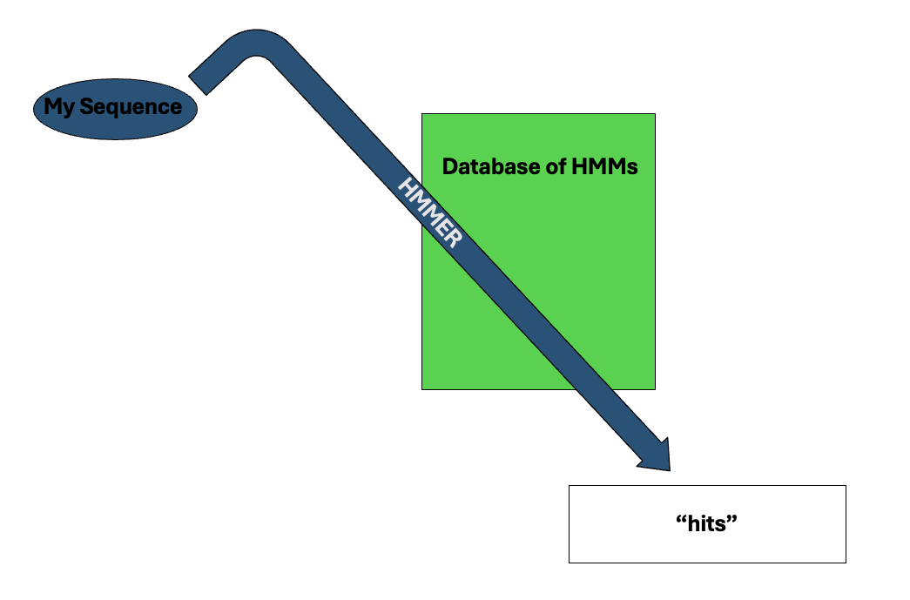
Hidden Markov Models (HMMs)
That calls for a probabilistic model of the family, not a single reference sequence.

Slide 28
Hidden Markov Models (HMMs)
A Markov model describes a system that moves between a finite set of states, where the probability of the next state depends only on the current one.
In a hidden Markov model, we don't directly observe the states. We only observe a sequence of symbols (here, nucleotides or amino acids) that each state emits according to its own emission probability distribution.
The task is to infer the hidden path of states that most plausibly explains the observed sequence.
An HMM is fully specified by:
A set of hidden states.
Transition probabilities between states.
Emission probabilities for each state, the probability of emitting each possible symbol.
Initial (start) state probabilities.

Slide 29
A simple DNA HMM
ACA---ATG
TCAACTATC
ACAC--AGC
AGA---ATC
ACCG--ATC
Five species have slightly different DNA binding sites for a regulatory protein

Slide 30
A simple DNA HMM
ACA---ATG
TCAACTATC
ACAC--AGC
AGA---ATC
ACCG--ATC
.4
A .2
C .4
G .2
T .2
state
state
state
state
.6
.6
A .8
C
G
T .2
A
C .8
G .2
T
A .8
C .2
G
T
A 1
C
G
T
A
C
G .2
T .8
A
C .8
G .2
T
1.0
1.0
.4
1.0
1.0

Slide 31
A simple DNA HMM
ACA---ATG
TCAACTATC
ACAC--AGC
AGA---ATC
ACCG--ATC
.4
A .2
C .4
G .2
T .2
emission
transition
state
state
.6
.6
A .8
C
G
T .2
A
C .8
G .2
T
A .8
C .2
G
T
A 1
C
G
T
A
C
G .2
T .8
A
C .8
G .2
T
1.0
1.0
.4
1.0
1.0

Slide 32
A simple DNA HMM
ACA---ATG
TCAACTATC
ACAC--AGC
AGA---ATC
ACCG--ATC
.4
A .2
C .4
G .2
T .2
state
state
.6
.6
A .8
C
G
T .2
A
C .8
G .2
T
A .8
C .2
G
T
A 1
C
G
T
A
C
G .2
T .8
A
C .8
G .2
T
1.0
1.0
.4
1.0
1.0

Slide 33
A simple DNA HMM
ACA---ATG
TCAACTATC
ACAC--AGC
AGA---ATC
ACCG--ATC
.4
A .2
C .4
G .2
T .2
state
state
.6
.6
A .8
C
G
T .2
A
C .8
G .2
T
A .8
C .2
G
T
A 1
C
G
T
A
C
G .2
T .8
A
C .8
G .2
T
1.0
1.0
.4
1.0
1.0

Slide 34
A simple DNA HMM
ACA---ATG
TCAACTATC
ACAC--AGC
AGA---ATC
ACCG--ATC
.4
A .2
C .4
G .2
T .2
state
state
.6
.6
A .8
C
G
T .2
A
C .8
G .2
T
A .8
C .2
G
T
A 1
C
G
T
A
C
G .2
T .8
A
C .8
G .2
T
1.0
1.0
.4
1.0
1.0

Slide 35
A simple DNA HMM
ACA---ATG
TCAACTATC
ACAC--AGC
AGA---ATC
ACCG--ATC
.4
A .2
C .4
G .2
T .2
state
state
.6
.6
A .8
C
G
T .2
A
C .8
G .2
T
A .8
C .2
G
T
A 1
C
G
T
A
C
G .2
T .8
A
C .8
G .2
T
1.0
1.0
.4
1.0
1.0

Slide 36
A simple DNA HMM
ACA---ATG
TCAACTATC
ACAC--AGC
AGA---ATC
ACCG--ATC
.4
A .2
C .4
G .2
T .2
state
state
.6
.6
A .8
C
G
T .2
A
C .8
G .2
T
A .8
C .2
G
T
A 1
C
G
T
A
C
G .2
T .8
A
C .8
G .2
T
1.0
1.0
.4
1.0
1.0

Slide 37
A simple DNA HMM
ACA---ATG
TCAACTATC
ACAC--AGC
AGA---ATC
ACCG--ATC
.4
A .2
C .4
G .2
T .2
P(ACAATG)=0.0328
state
state
.6
.6
Multiple the probabilities!
A .8
C
G
T .2
A
C .8
G .2
T
A .8
C .2
G
T
A 1
C
G
T
A
C
G .2
T .8
A
C .8
G .2
T
1.0
1.0
.4
1.0
1.0

Slide 38
A simple DNA HMM
ACA---ATG
TCAACTATC
ACAC--AGC
AGA---ATC
ACCG--ATC
.4
A .2
C .4
G .2
T .2
P(ACAATG)=0.0328
P(ACCGATC)=0.006
state
.6
.6
Multiple the probabilities!
A .8
C
G
T .2
A
C .8
G .2
T
A .8
C .2
G
T
A 1
C
G
T
A
C
G .2
T .8
A
C .8
G .2
T
1.0
1.0
.4
1.0
1.0

Slide 39
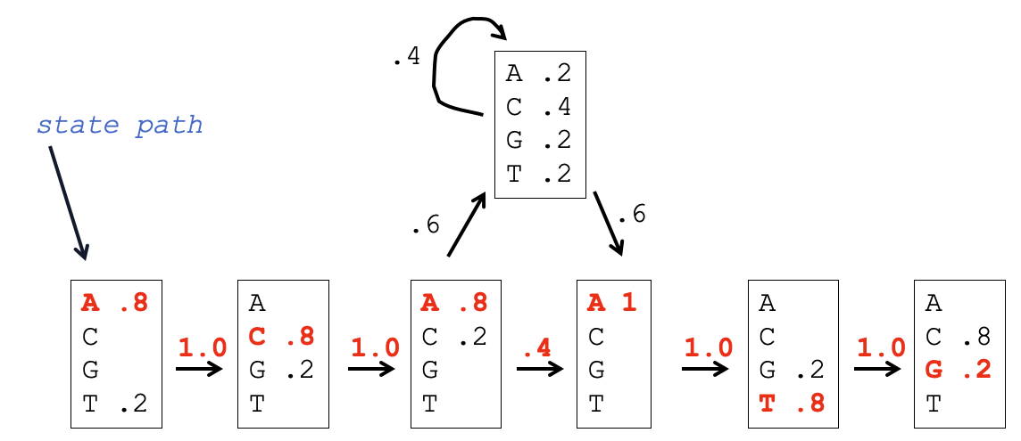
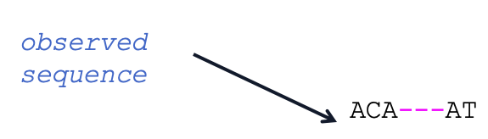
Hidden Markov Models (HMMs)
A Markov model describes a system that moves between a finite set of states, where the probability of the next state depends only on the current one.
In a hidden Markov model, we don't directly observe the states. We only observe a sequence of symbols (here, nucleotides or amino acids) that each state emits according to its own emission probability distribution.
The task is to infer the hidden path of states that most plausibly explains the observed sequence.

Slide 40
Hidden Markov Models (HMMs)
A Markov model describes a system that moves between a finite set of states, where the probability of the next state depends only on the current one.
In a hidden Markov model, we don't directly observe the states. We only observe a sequence of symbols (here, nucleotides or amino acids) that each state emits according to its own emission probability distribution.
The task is to infer the hidden path of states that most plausibly explains the observed sequence.
An HMM is fully specified by:
A set of hidden states.
Transition probabilities between states.
Emission probabilities for each state, the probability of emitting each possible symbol.
Initial (start) state probabilities.

Slide 41
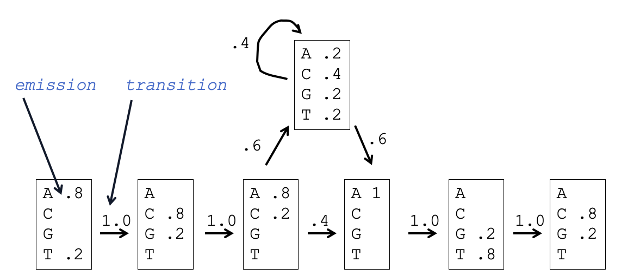
Hidden Markov Models (HMMs)
A Markov model describes a system that moves between a finite set of states, where the probability of the next state depends only on the current one.
In a hidden Markov model, we don't directly observe the states. We only observe a sequence of symbols (here, nucleotides or amino acids) that each state emits according to its own emission probability distribution.
The task is to infer the hidden path of states that most plausibly explains the observed sequence.
An HMM is fully specified by:
A set of hidden states.
Transition probabilities between states.
Emission probabilities for each state
Initial (start) state probabilities.

Slide 42
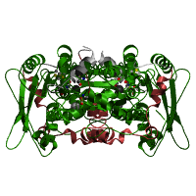
Pfam Iron Hydrogenase HMM
D9QTQ6_ACEAZ/525-580 MDV--KAKRAEALYQTD---KA-NTI--RKSHENPQIIKLYE---D----YL-GE-P-L-----SSDSHHLLHTSYQER
E3DPJ1_HALPG/515-570 NEK--KEKRGSGLSNID---DS-SKI--RKSHENPQIIKLYE---E----FL-GE-P-L-----GGESHHLLHTKYKAR
E4RJ60_HALHG/516-571 YEK--KVKRGVGLSGID---DK-SAV--RKSHKNPQVIKLYK---E----FL-GK-P-L-----SGESHHLLHTTYKSR
Q0AVN1_SYNWW/44-102 DDY--IAKRAAGLYTLD---ES-MAI--RKSHENPEVIQIYQ---D----FL--S-P-GKLECVSPKAHHLLHTKYGQ-
D7CNL1_SYNLT/44-102 DDY--IAKRAQGLYTLD---EK-MTI--RKSHENPEIIQLYK---D----FL--S-P-GEVKPMSEKAHHLLHTRYGQ-
L0KCP1_HALHC/517-572 KEI--KAKRGQGLYNID---QS-DKI--RKSHENPEIKKLYE---D----FL-GA-P-L-----SEKAHHLLHTNYQKR
R5AAQ0_9FIRM/470-524 EEL--YGVRGERLYTLD---AE-NPM--RFAHENPEVQALYH---E----YL-GE-P-L-----GETAHHLLHTDHKA-
F7V3Y0_CLOSS/515-570 KEM--AASRAPILYAFD---QI-TDL--RFSHENPSITKVYS---E----YL-GE-P-L-----SEKSHHLLHTDHHAW
R7B2L8_9BACE/516-570 QEL--AKDRAPILYSLD---RS-KNI--RFSHENPDVLKMYE---E----FF-EK-P-N-----SPVAHKLLHTDHHA-
R5TQ56_9FIRM/517-570 -EL--ADVRGRNLYKLD---KK-NPL--RFSHENPSVIKAYE---D----FF-EK-P-L-----SHKSHELLHTDHEA-
R6G054_9FIRM/519-572 KEM--AEIRSKNLYFLD---SQ-NER--RFSHENPEVLKTYE---E----YL-EK-P-L-----SRMSHKLLHTDHH--
F4GHP6_SPHCD/517-571 -EL--ASTRADVLYGLD---KV-DNL--RFSHENPSVLKAYE---S----FF-GK-P-L-----GHKCHELLHTDHHAW
R6K3U5_9FIRM/237-290 -DK--VAERCKVLYGLD---KV-NNV--RFSHENPEVLQCYR---D----YF-KE-P-L-----SEKSHELLHTSHTV-
R7BDK2_9FIRM/518-573 VEM--AADRAKELYKLD---KN-KQI--RFSHCNPEIHTIYK---E----YF-GK-P-L-----SPVSHHLLHTDHKYR
R6A2A7_9ACTN/541-595 -EL--AAERGQVLWGLD---AK-ADI--RFSHENPGVQACYR---E----FL-GA-P-L-----SPLAEELLHTDHHAW
R7D1R5_9ACTN/521-575 VEL--ADERAAVLRALD---HD-AQI--RFSHENPDVAACYR---D----FL-GE-P-L-----SELSEKLLHTDHTA-
G4KSU3_OSCVS/517-571 VEM--AAERGELLWELD---AK-SKI--RFSHENPDIKTLYS---E----YL-KE-P-L-----GKKSHHLLHTDHAA-
R6GQ90_9FIRM/517-572 VEL--AEKRGSVLWSID---KA-SPC--RFSHENPDVRELYR---D----YL-KK-P-L-----SDVSHHLLHTDHQAW
R5D0I3_9FIRM/517-570 TEM--AEARGNVLWSID---KK-SPV--RFSHENPEVQTLYR---E----YL-RA-P-L-----SGRSHHLLHTDHE--
R6Q6Y7_9FIRM/517-570 --Q--AERRGNHLYFLD---DI-ANL--RFSHENPAIQALYK---N----FL-GE-P-L-----GEKAHHLLHTDHTAW
R6RTM0_9FIRM/518-571 QEL--AEERGSSLYFLD---RD-TEI--RFSHDNPDIQNLYE---E----FF-EK-P-L-----SHRAHQLLHTEHQ--
Q73MB6_TREDE/520-573 GEL--AVKRGSNLYFID---KN-SKV--RYSHENECIKALYN---D----FF-EK-P-N-----SHKAHSLLHTDHF--
R5J469_9CLOT/520-573 -EM--AFERGKNLYFLD---EN-ADI--RRSHENPDVKALYD---N----YF-EQ-P-L-----SHKSHMLLHTDHNK-
D4M4H0_9FIRM/519-573 EEL--AHTRGANLYFLD---KN-AKI--RFSHENQDVMKLYN---D----FL-EK-P-L-----SHKSHMLLHTDHTK-
R6LI15_9FIRM/519-573 EEL--ARTRGENLYFLD---KN-APL--RFSHENPDVLRLYR---D----FF-EK-P-L-----SHKSHMLLHTDHNA-
F0T2S8_SYNGF/456-511 DTI--RTQRSNSLYTLD---KN-AKV--RNSHENTEITQIYK---D----YL-HA-P-M-----SHLAEEILHTEYESR
A5D4I9_PELTS/463-518 DTV--REQRLAALYKAD---ASLSK---RKSYENEEVAALYR---D----FL-GH-P-M-----SELAEELLHTEYHSR
R4KFN4_9FIRM/459-514 DEV--RMQRINSLYQAD---AR-AQR--RESHENAEVLALYQ---N----FL-KH-P-M-----SELAEELLHTKYTDR
F6DPY8_DESRL/455-511 DQV--RQARLNSLYTMD---AKMYKK--RLSHENSEVLQLYK---N----YL-EQ-P-M-----SHLAEELLHTEYTDR

Slide 43
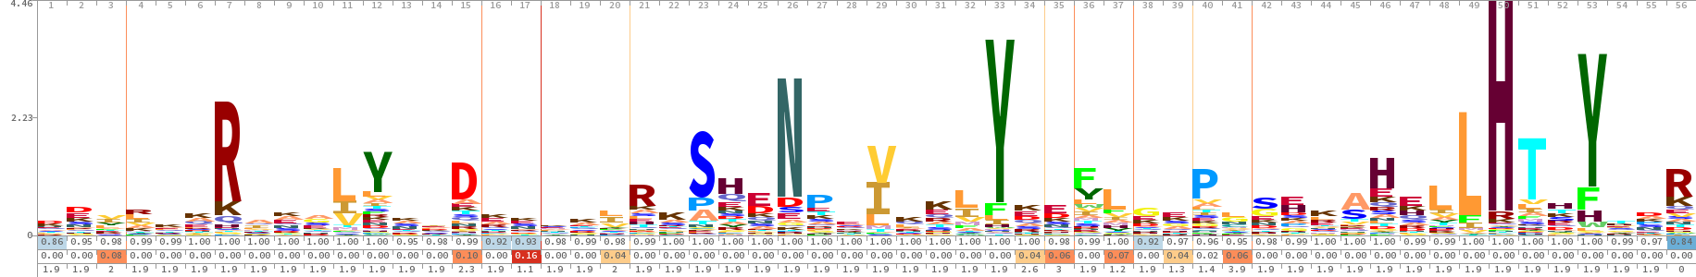
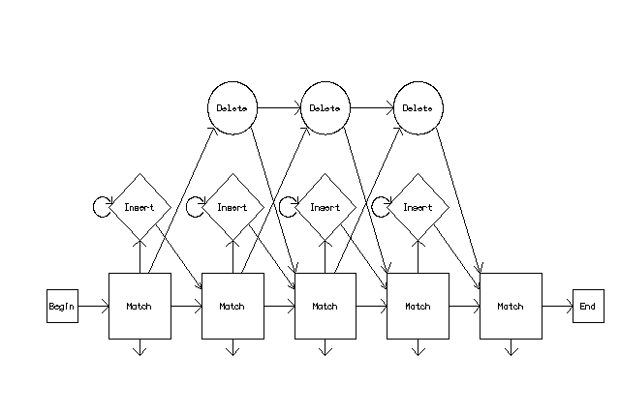
Pfam Iron Hydrogenase HMM
Sequence variation with some conservation
HMMER / Pfam has a generalized HMM that can be trained by any protein domain

Slide 44
Pfam Iron Hydrogenase HMM
HMM A C D E F G H I K L M N P Q R S T V W Y
m->m m->i m->d i->m i->i d->m d->d
COMPO 2.66299 4.87199 2.91679 2.55591 3.66715 3.29500 2.87691 3.09550 2.45416 2.39490 3.84919 3.01061 3.43251 3.03167 2.71247 2.66673 2.90997 3.06188 5.21245 2.88414
2.68618 4.42225 2.77519 2.73123 3.46354 2.40513 3.72494 3.29354 2.67741 2.69355 4.24690 2.90347 2.73739 3.18146 2.89801 2.37887 2.77519 2.98518 4.58477 3.61503
0.15412 5.62693 1.97159 0.61958 0.77255 0.00000 *
1 2.69450 5.20126 1.90404 2.47178 4.68913 3.78335 4.01145 3.75163 2.20418 2.96186 3.33300 2.43140 3.49632 2.59266 3.14923 2.72610 2.90370 2.98968 5.61412 4.41752 1 d - - C
2.68618 4.42225 2.77519 2.73123 3.46354 2.40513 3.72494 3.29354 2.67741 2.69355 4.24690 2.90347 2.73739 3.18146 2.89801 2.37887 2.77519 2.98518 4.58477 3.61503
0.00718 5.47902 5.81517 0.61958 0.77255 0.42007 1.07002
2 2.91083 4.82906 1.58312 1.73987 5.01707 3.82147 3.64171 4.50313 2.01029 3.15122 4.59410 2.83954 4.25294 3.15745 3.12709 2.65971 3.16946 3.83508 6.10447 4.69344 2 d - - C
2.68618 4.42225 2.77519 2.73123 3.46354 2.40513 3.72494 3.29354 2.67741 2.69355 4.24690 2.90347 2.73739 3.18146 2.89801 2.37887 2.77519 2.98518 4.58477 3.61503
0.00559 5.58603 6.30838 0.61958 0.77255 0.42789 1.05522
3 2.63456 4.70051 4.84319 2.98389 2.64502 4.37715 4.37000 1.96988 3.23179 2.30513 3.40557 3.77117 4.64207 4.19062 3.25571 3.40775 2.92268 1.80829 5.12858 2.21226 3 v - - H
2.68582 4.42236 2.77514 2.73093 3.46365 2.40524 3.72482 3.29365 2.67744 2.69351 4.24701 2.90358 2.73751 3.18157 2.89791 2.37890 2.77525 2.98529 4.58488 3.61514
0.08136 2.57205 6.34224 0.67760 0.70894 0.47041 0.98016
4 2.54801 4.72728 4.74569 4.15699 3.82991 4.36365 4.46123 1.93633 2.71591 1.80176 2.81197 4.19038 4.73278 4.00802 1.74668 3.65099 3.31186 2.37869 5.33916 3.48167 6 r - - H
2.68618 4.42225 2.77519 2.73123 3.46354 2.40513 3.72494 3.29354 2.67741 2.69355 4.24690 2.90347 2.73739 3.18146 2.89801 2.37887 2.77519 2.98518 4.58477 3.61503
0.00537 5.62610 6.34845 0.61958 0.77255 0.48306 0.95944
5 2.11055 5.19463 3.13477 2.25423 4.84332 3.10661 3.88848 3.85885 1.98083 2.26284 3.93265 3.22775 4.35588 2.50230 2.73835 2.86546 2.72615 3.35148 6.10956 4.57738 7 k - - H
2.68618 4.42225 2.77519 2.73123 3.46354 2.40513 3.72494 3.29354 2.67741 2.69355 4.24690 2.90347 2.73739 3.18146 2.89801 2.37887 2.77519 2.98518 4.58477 3.61503
0.00536 5.62693 6.34927 0.61958 0.77255 0.48576 0.95510
6 2.03322 4.91437 2.94559 2.42989 5.02036 3.66309 4.04897 3.63439 1.52459 2.77931 3.89988 3.20092 4.15513 2.30684 2.83680 2.92417 3.25333 3.61800 6.11737 4.70998 8 k - - H
2.68618 4.42225 2.77519 2.73123 3.46354 2.40513 3.72494 3.29354 2.67741 2.69355 4.24690 2.90347 2.73739 3.18146 2.89801 2.37887 2.77519 2.98518 4.58477 3.61503
0.00536 5.62693 6.34927 0.61958 0.77255 0.48576 0.95510
7 4.73891 6.64548 5.68057 4.42078 6.41719 5.15128 3.93502 5.55175 2.29408 4.78890 5.71680 4.63644 5.41712 2.87234 0.31067 4.69020 4.75225 5.28095 6.66515 5.69420 9 R - - H
2.68618 4.42225 2.77519 2.73123 3.46354 2.40513 3.72494 3.29354 2.67741 2.69355 4.24690 2.90347 2.73739 3.18146 2.89801 2.37887 2.77519 2.98518 4.58477 3.61503
0.00536 5.62693 6.34927 0.61958 0.77255 0.48576 0.95510
8 1.62426 4.44842 4.26891 3.69735 3.86164 3.13257 4.52444 2.32789 3.39179 2.57955 2.66032 3.91731 4.63345 2.24662 2.85057 3.03169 2.70601 2.61172 5.46972 4.25065 10 a - - C
2.68618 4.42225 2.77519 2.73123 3.46354 2.40513 3.72494 3.29354 2.67741 2.69355 4.24690 2.90347 2.73739 3.18146 2.89801 2.37887 2.77519 2.98518 4.58477 3.61503
0.00536 5.62693 6.34927 0.61958 0.77255 0.48576 0.95510

Slide 45
Hidden Markov Models (HMMs)
There are many probable state paths for an observed sequence for an HMM
The Viterbi algorithm is guaranteed to find the most probable state path given a sequence and an HMM.
The query generates a probability for every HMM in the database

Slide 46
HMMs in Pfam/Hmmer
The HMMER software uses the probability values to calculate:
  bit score – a log-odds score of the fit of the query to the HMM; the higher the score, the better the alignment
  expectation value - estimates the likelihood that a given match is purely by chance; a function of database size
Pfam website uses a default expectation value cut-off of 1.0

Slide 47
HMMs in Pfam/Hmmer
Pfam HMMs are curated by functional biologists and model functional domains; Pfam HMMs are thus one of the most powerful tools available for prediction of protein function
Caveat – correlations among residues cannot be modeled by HMMs as Markov Chains cannot ‘remember’ earlier states; secondary structure not workable in HMMs

Slide 48
What about finding short sequences?
Short sequences or motifs by definition have less information
  Often too short for BLAST (below word size or extension rules)
  Not enough information to build an HMM
  Easily match random sequences – expectation values break down
  Statistical confidence and avoidance of false discovery difficult for reasons listed above – experimental validation often required
Two common bioinformatics questions
  Detection of amino acid motifs, e.g. PROSITE database
  Detection of DNA binding sites, e.g. JASPAR database

Slide 49
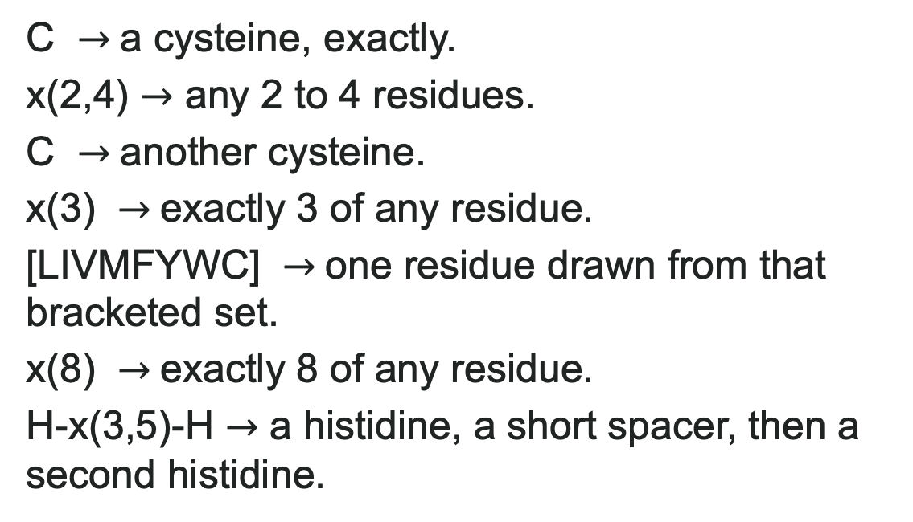
What about finding short sequences?
1
Pattern matching
Not statistical – the pattern exists in the subject or not
  Frequently important for analysis of proteins (e.g. PROSITE)
  Computers are very good at pattern matching – fast!
C $→$a cysteine, exactly.
x(2,4) $→$ any 2 to 4 residues.
C $→$another cysteine.
x(3) $→$exactly 3 of any residue.
[LIVMFYWC] $→$one residue drawn from that bracketed set.
x(8) $→$exactly 8 of any residue.
H-x(3,5)-H $→$ a histidine, a short spacer, then a second histidine.
PROSITE pattern syntax — the zinc-finger (C2H2 type) signature
C-x(2,4)-C-x(3)-[LIVMFYWC]-x(8)-H-x(3,5)-H

Slide 50
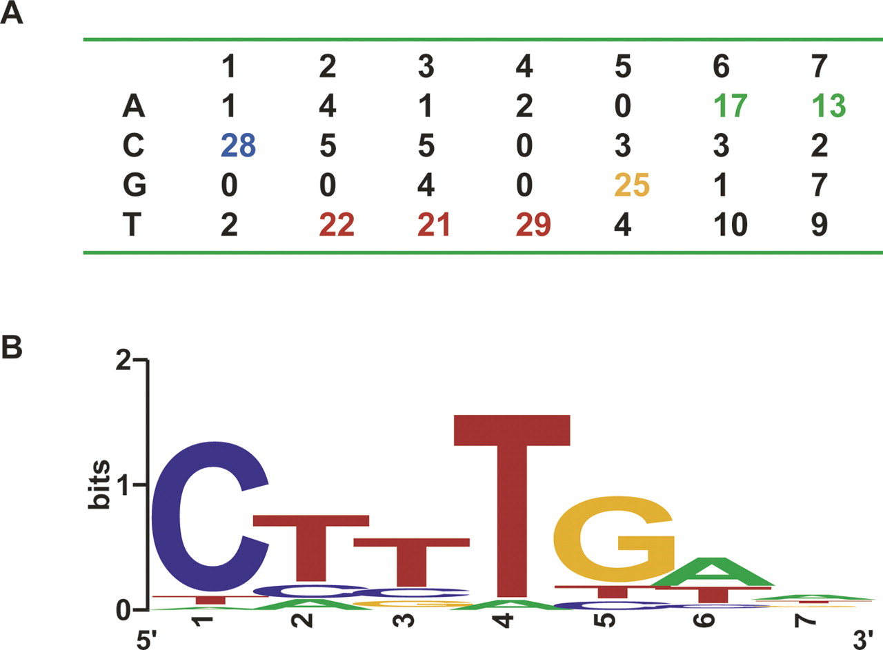
What about finding short sequences?
2
Position-specific scoring matrix (PSSM)
  A pattern with variation based on observation
  Particularly important for analysis of DNA binding sites (e.g. JASPAR database)
  Statistical in nature, but very high false discovery rate!

Slide 51
Summary of sequence of analysis methods
Method | What is compares against | Speed | Sensitivity to variation
Smith–Waterman | one sequence vs one sequence, exactly | slow | optimal, but only for that one pair
BLAST | one sequence vs a whole database, heuristically | very fast | can miss short/weak seeds
PROSITE | a fixed rule | very fast | brittle, no tolerance
PSSM | a fixed-length, position-scored motif | fast | tolerant
Profile HMM | a whole family, probabilistically | slower than BLAST | most sensitive, built for divergence

Slide 52
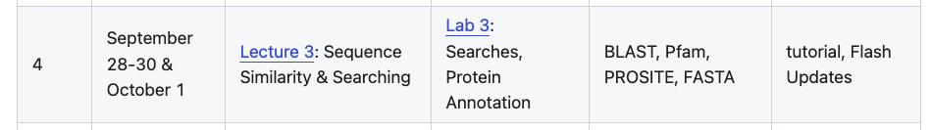
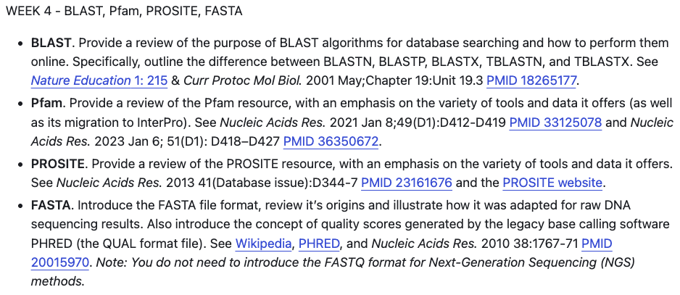
This week …

